Slide 1



Chocolate Sales Data
Sales Data Analysis Project
By Navith Apzal M

Slide 2


Table of contents
01
02
03
04
05
06
Introduction
Data Analysis & Uses of Formula
Pivot Tables & Pivot Charts
What if Analysis & Goal Seek
Dashboard Creation
Dashboard Overview

Slide 3
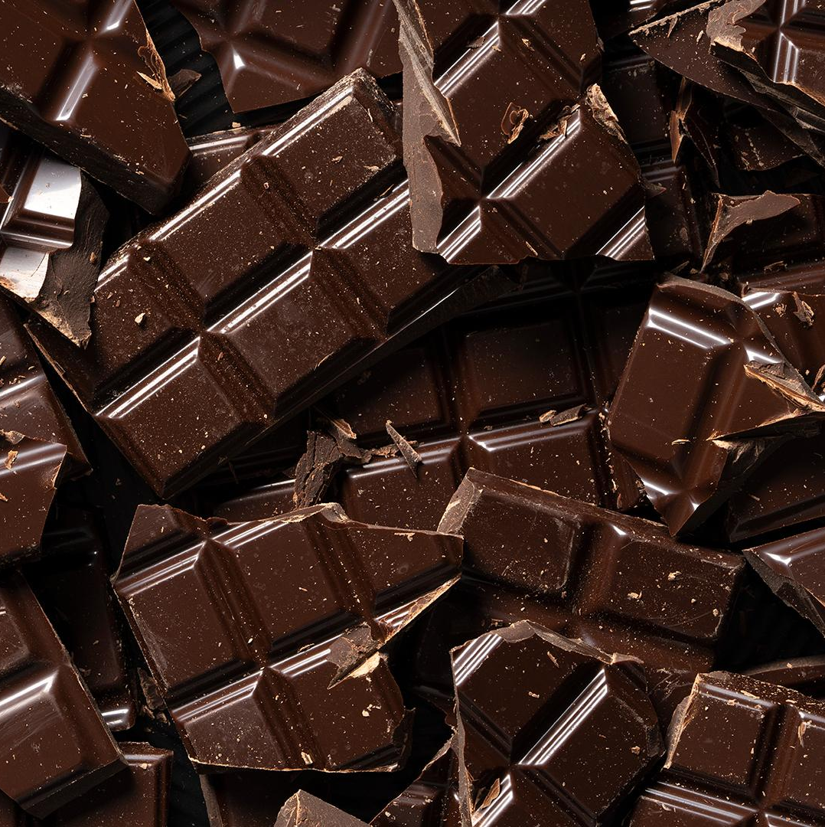

Introduction
01
About the Project:-
•Project: Chocolate Sales Data Analysis
•Tool Used: Microsoft Excel
•Objective: Analyze chocolate sales data using formulas, Pivot Tables, and Dashboards.Dataset Columns are Sales Person, Country, Product, Date, Amount, Boxes Shipped etc.

Slide 4
Data Analysis & Uses Of Formula
02
Data Cleaning
Removed Duplicates, fixed all type of formats
Data Analysis
Added New Columns
Months, Date, Total Profit & Cost Per Box etc.
Insights
More Chocolates Shipped to Australia(21%) & Total Profitable Country was India

Slide 5
Uses Of Formula
SUM (Total Sales & Profits)
AVERAGE (Average Sales)
MAX (Maximum Sales, Maximum Cost)
MATCH (It Searches Specified Item in a Range of Cells)
INDEX (Index function returns a value or reference from a specified range)
IF (Test a Condition and Returns a Value)
Uses Of Formula

Slide 6
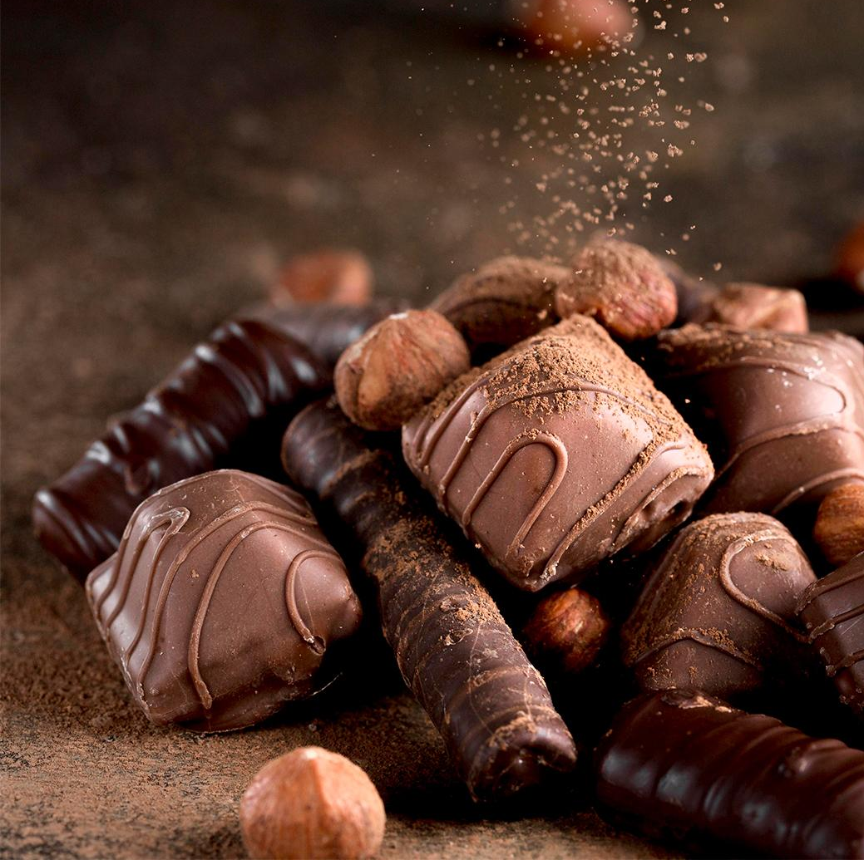

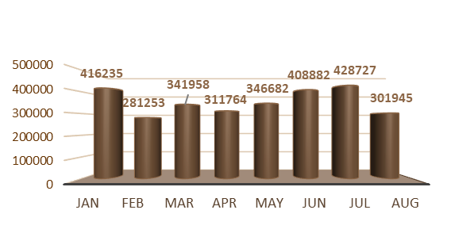

Pivot Tables & Pivot Charts
03
Pivot Tables Used:-
Sales By Month
Top 10 Profitable Products
Units Sold By Country
Total Shipments By Country
Pivot Charts Used:-
Line Chart
Pie Chart
Column Chart

Slide 7


What If Analysis & Goal Seek
What If Analysis
Checked 10% Of Increase Effect On Total Sales & Used to simulate different sales scenarios (for adjusting price or quantity) to see how they impact outcomes.
Goal Seek
Founded Chocolate Boxes to reach Rs. 100,000 as a Target & Helped sales targets and pricing strategies to reach revenue goals.
04

Slide 8
Dashboard Creation
05
Dashboard Features:
Created a Interactive Chocolate Sales Dashboard
KPIs: Total Sales,Total Profit, Total Profit (Per Box),Total Cost, Total Boxes, Avg Revenue per Box, Top Salesperson.
Interactive Slicers: Country, Month.
Charts: Bar, Line, Pie
Created with a Simple and Clean Design with Filters

Slide 9
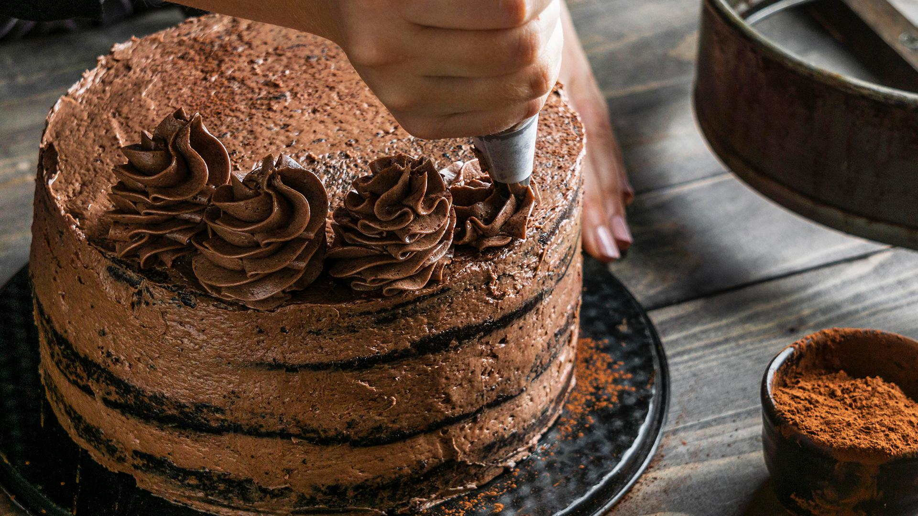
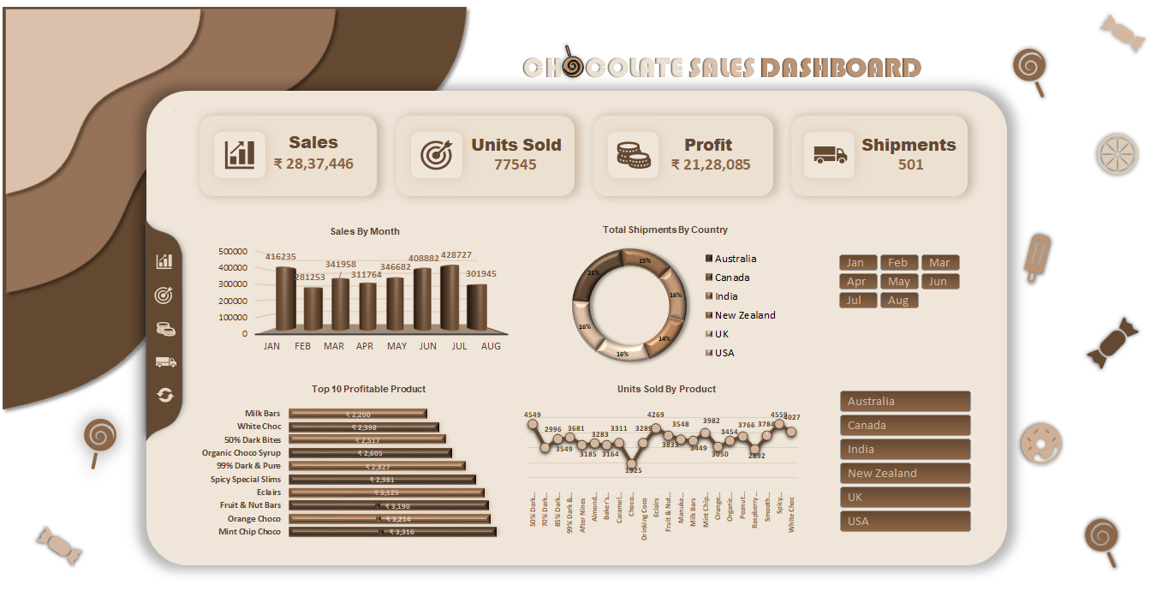
Dashboard Overview

Slide 10



Thank You
Thanks

